Slide 1

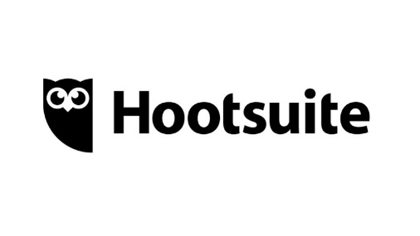
Aligned – Social Media Strategy and Support
Client Need
Aligned is a data center infrastructure technology company that specializes in scalable solutions for growing businesses. Aligned needed a partner to help manage its corporate social media accounts and the LinkedIn accounts of four corporate executives. It wanted to grow brand awareness as measured by engagement and impressions.
What We Did
Affirma proposed a social media strategy encompassing Aligned’s corporate Facebook, Twitter, and LinkedIn accounts, as well as four executive LinkedIn profiles. Affirma introduced Hootsuite as a social media marketing platform and used Google Forms to create a reporting system that fit the client’s needs. After an onramp period spent learning Aligned’s messaging priorities, Affirma began creating marketing posts for the corporate accounts and writing engaging thought leadership posts for the executive accounts centered around curated articles identified by Affirma that Aligned’s prospective clients were most likely to be interested in.
Results
In Aligned’s first three months partnering with Affirma, average monthly impressions doubled from the previous nine months, average monthly comments tripled, and average monthly follower growth grew 50%. Affirma continues to maintain support for Aligned’s social media accounts and see daily growth in follower count and interactions.
I have really positive feedback. The brand account posts are awesome and the growth we’re seeing in impressions and engagement is just what we hoped for. You’re quick to respond and incorporate feedback and make me feel like a valued customer.
- Joanna Soucy, VP Brand Strategy, Aligned

